Slide 1


Semi-Supervised Learning
Group 2
Atefeh Mahdavi
Tapas Joshi
Chandan P. Patil

Slide 2
Semi-Supervised Learning
Supervised Learning (completely training labeled data)
Unsupervised Learning (without any training labeled data)
Semi-Supervised Learning (A class of supervised learning tasks and techniques that makes use of unladed data for training)

Slide 3
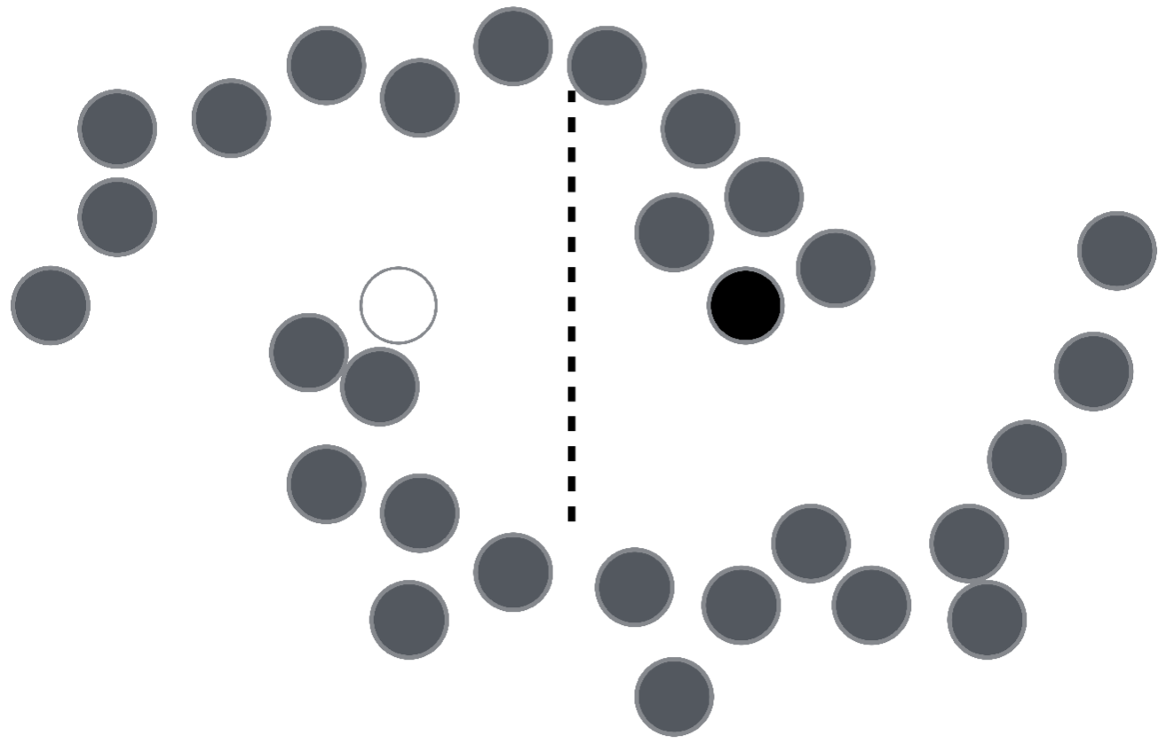
What if you see all the unlabeled data?
Semi-Supervised Learning with Ladder Networks

Slide 4
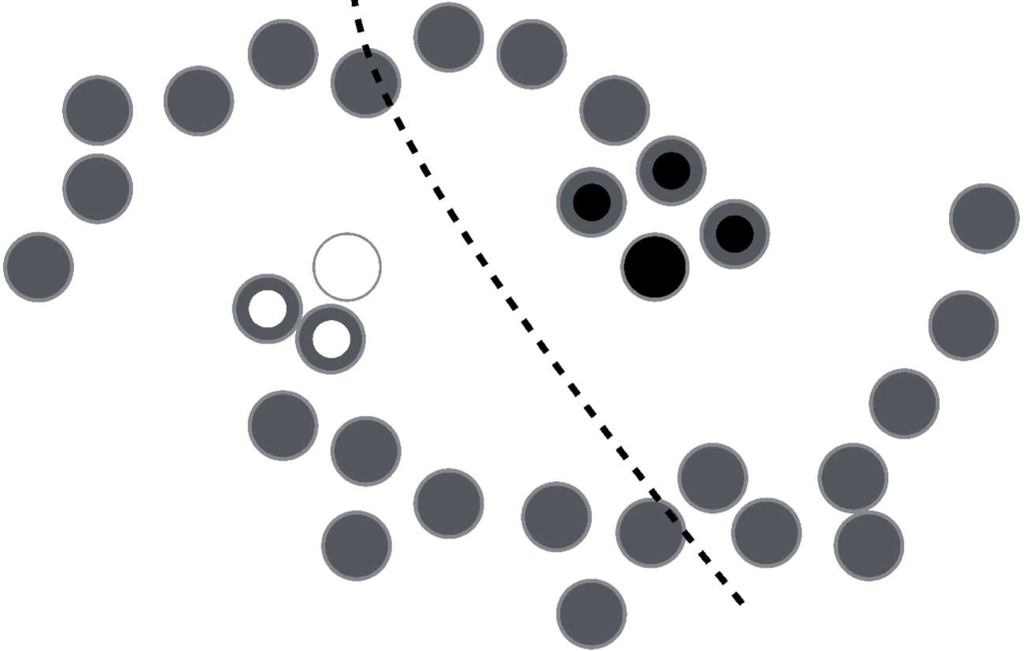
Labels are homogenous in densely populated space?

Slide 5
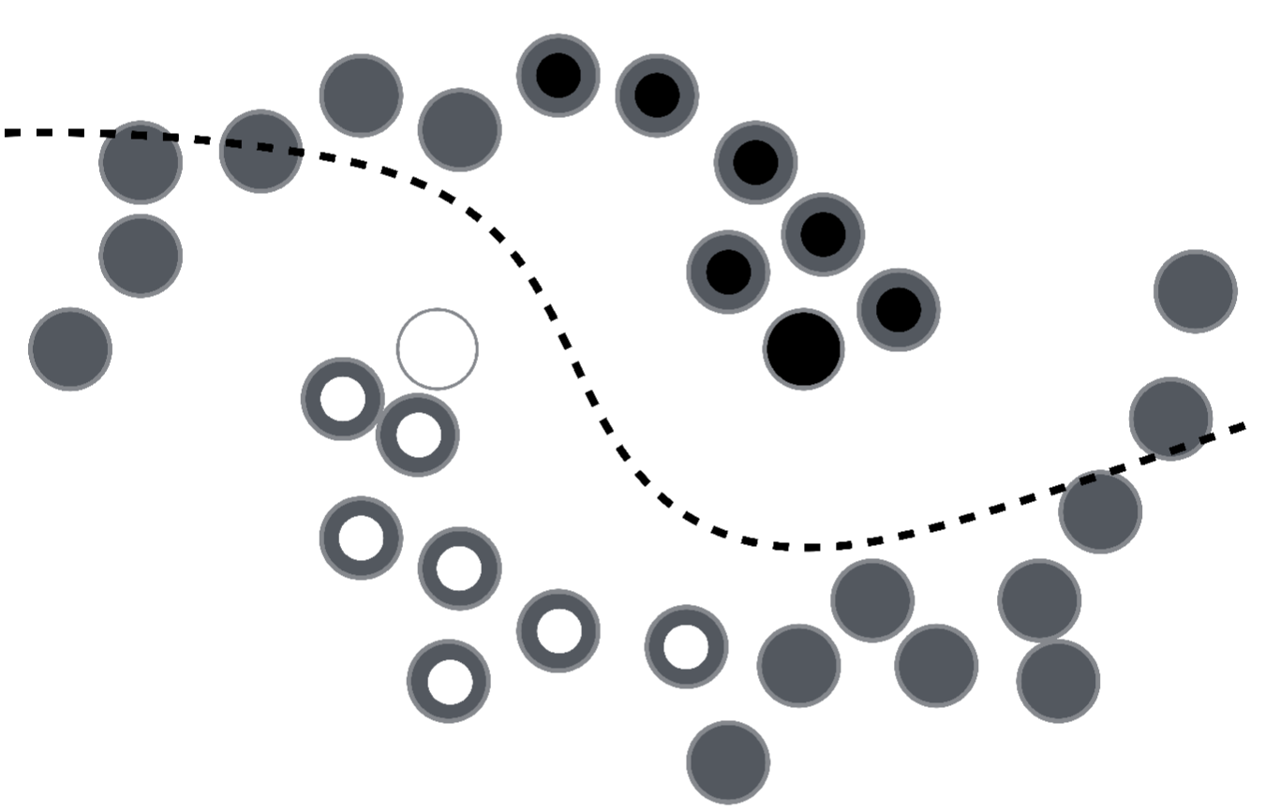
Labels are homogenous in densely populated space?

Slide 6
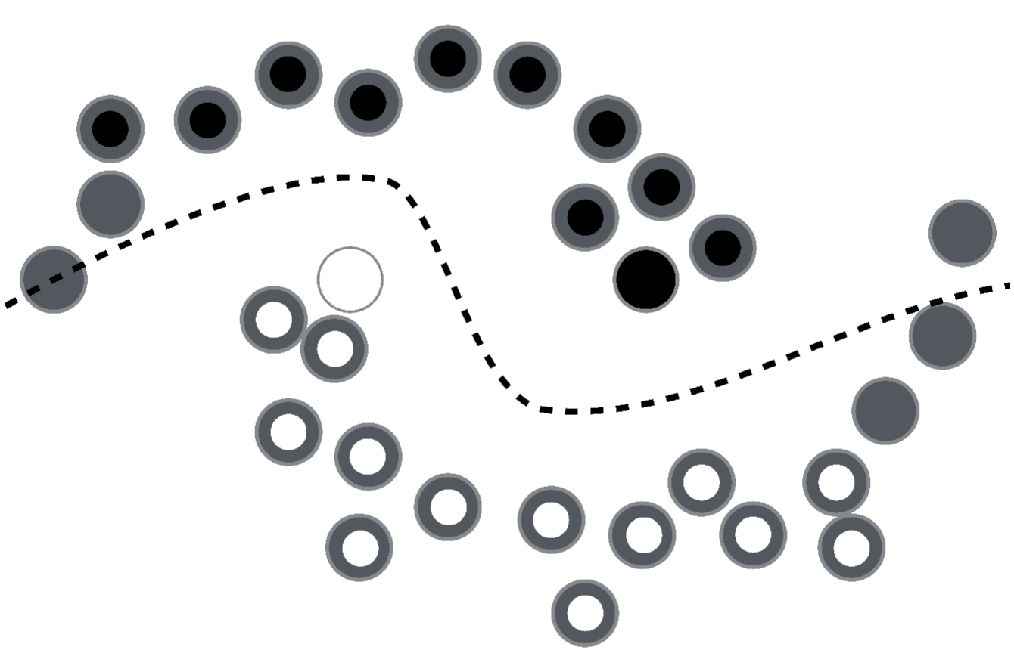
Labels are homogenous in densely populated space?

Slide 7
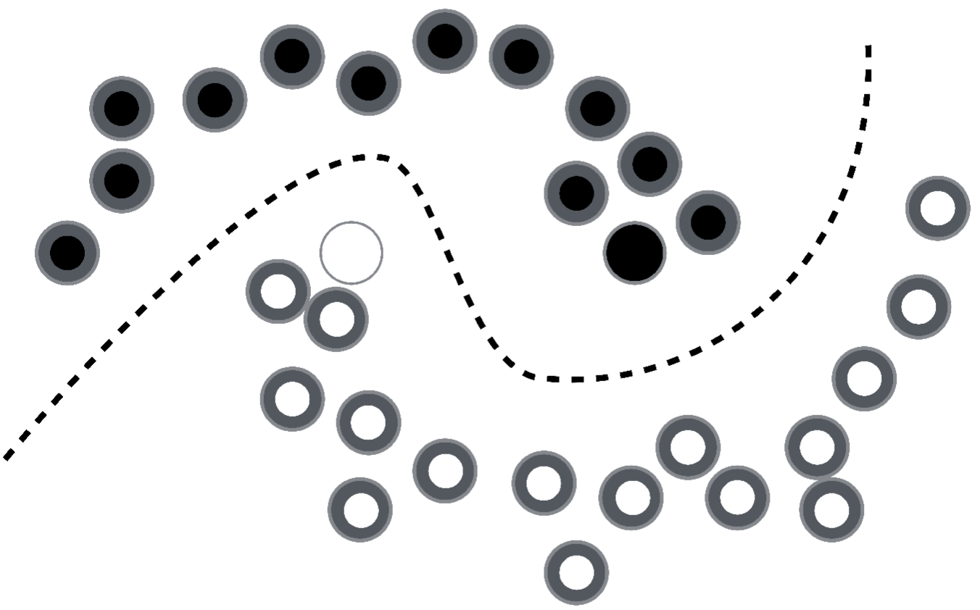
Labels are homogenous in densely populated space?

Slide 8
Ladder Network Implementation
Supervised
Unsupervised Learning only for pre-training
Feedforward Model
Encoder-Decoder Structure

Slide 9
Only for pre-training
Ladder Network: it is trained to minimize the cost by propagation
Ladder Network
Unsupervised
Supervised

Slide 10
Encoder as Supervised Learning
adds Gaussian noise
Supervised cost: Output of corrupted encoder and the output target
Encoder
Clean Encoder
Corrupted Encoder

Slide 11
Decoder as Unsupervised Learning
Target Denoising Function
Unsupervised cost : Difference between the reconstruction and the clean version
Activations
Clean Version
Corrupted Version

Slide 12
Final Cost
Final cost = Supervised Cost + Unsupervised Cost
Supervised cost – Output of corrupted encoder and the output target
Unsupervised cost – Sum of the denoising cost of all layers

Slide 13
Technical Implementation
Labelled data: {x_{t} , y_{t}} 1 ≤ t ≤ N
Unlabelled data: {x_{t}} N+1 ≤ t ≤ M
Often labelled data is scarce, unlabelled data is plentiful:
N << M

Slide 14

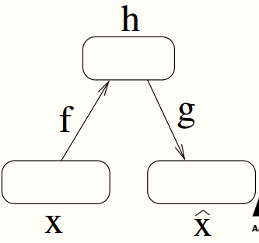
Technical Implementation
Corrupt input x_{t} with noise to get _{t}
Train P(y| ) with a target from clean q(y_{t}) = P(y_{t} |x_{t})
Encoder function f : x → h
Decoder function g : h →
Reconstruction

Slide 15
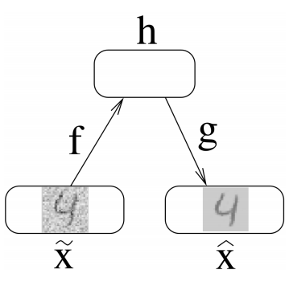
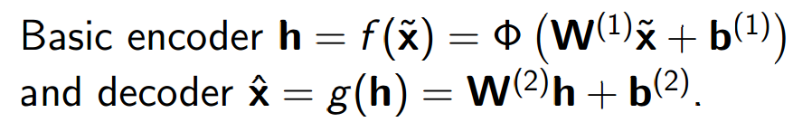
Denoising Autoencoder (DAE)
Reconstruction + Denoising
Reconstruction: Representation should be robust to the introduction of noise
Feeds corrupted inputs to x
Trains our function g(f(x)) to minimize reconstruction errors

Slide 16
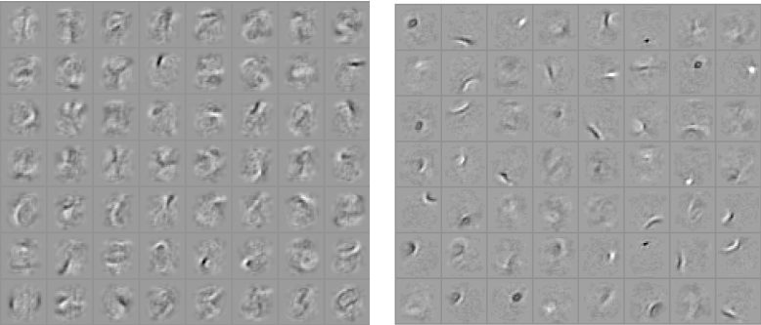
Analysis
Training a classifier (top), when you get the labels correct, learning stops. ⇒ Learned parameters are based on the information in labels: Less than #examples×#classes bits.
Training a denoising autoencoder (down), outputs are richer: #examples×#dimensions
Denoising models are much easier to train than probabilistic models as they are trainable by basic back-propagation.

Slide 17
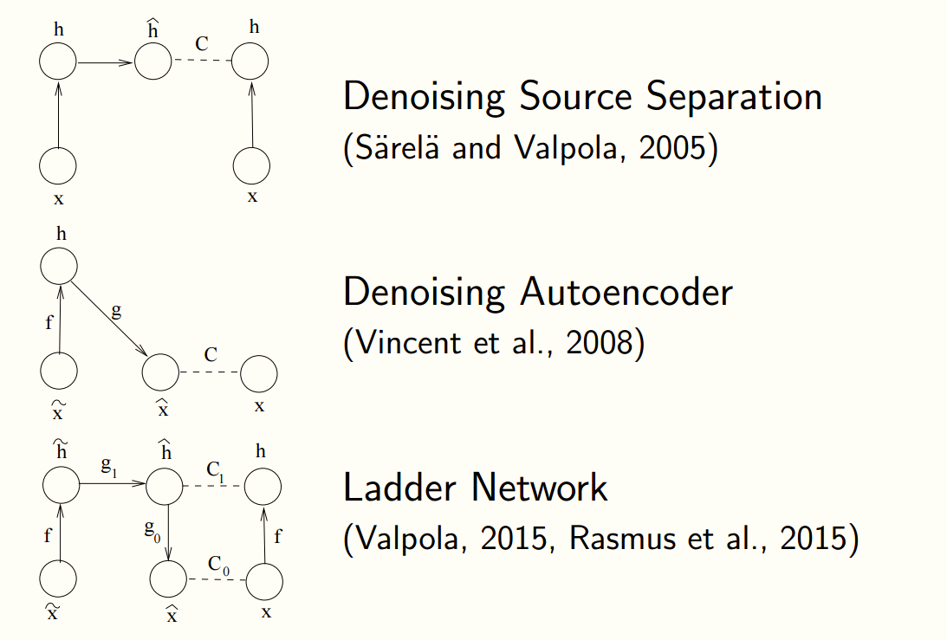
Combining DSS and DAE

Slide 18
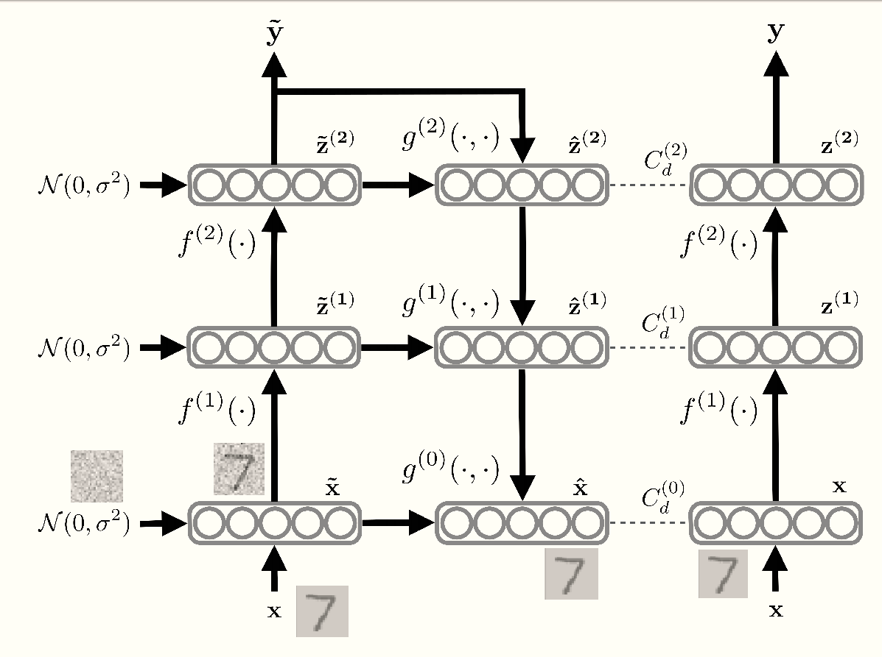
Ladder Network Architecture

Slide 19
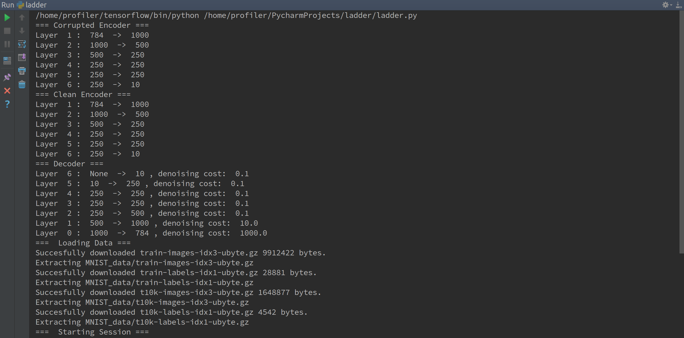
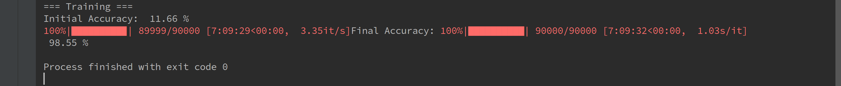
Code Results

Slide 20
Results – Time Comparison

Slide 21
Conclusion
Train the whole network using semi-supervised setting using the optimization techniques such as stochastic gradient descent to minimize cost
Quick to train
Flexible
Efficient in terms of costs

